Slide 1
TB Transmission in Prisons and Spillover into Communities:
Why Addressing Tuberculosis in Prisons Should be a Public Health Priority
Jason Andrews
Stanford University
AIDS 2018
Amsterdam, The Netherlands
July 24, 2018

Slide 2
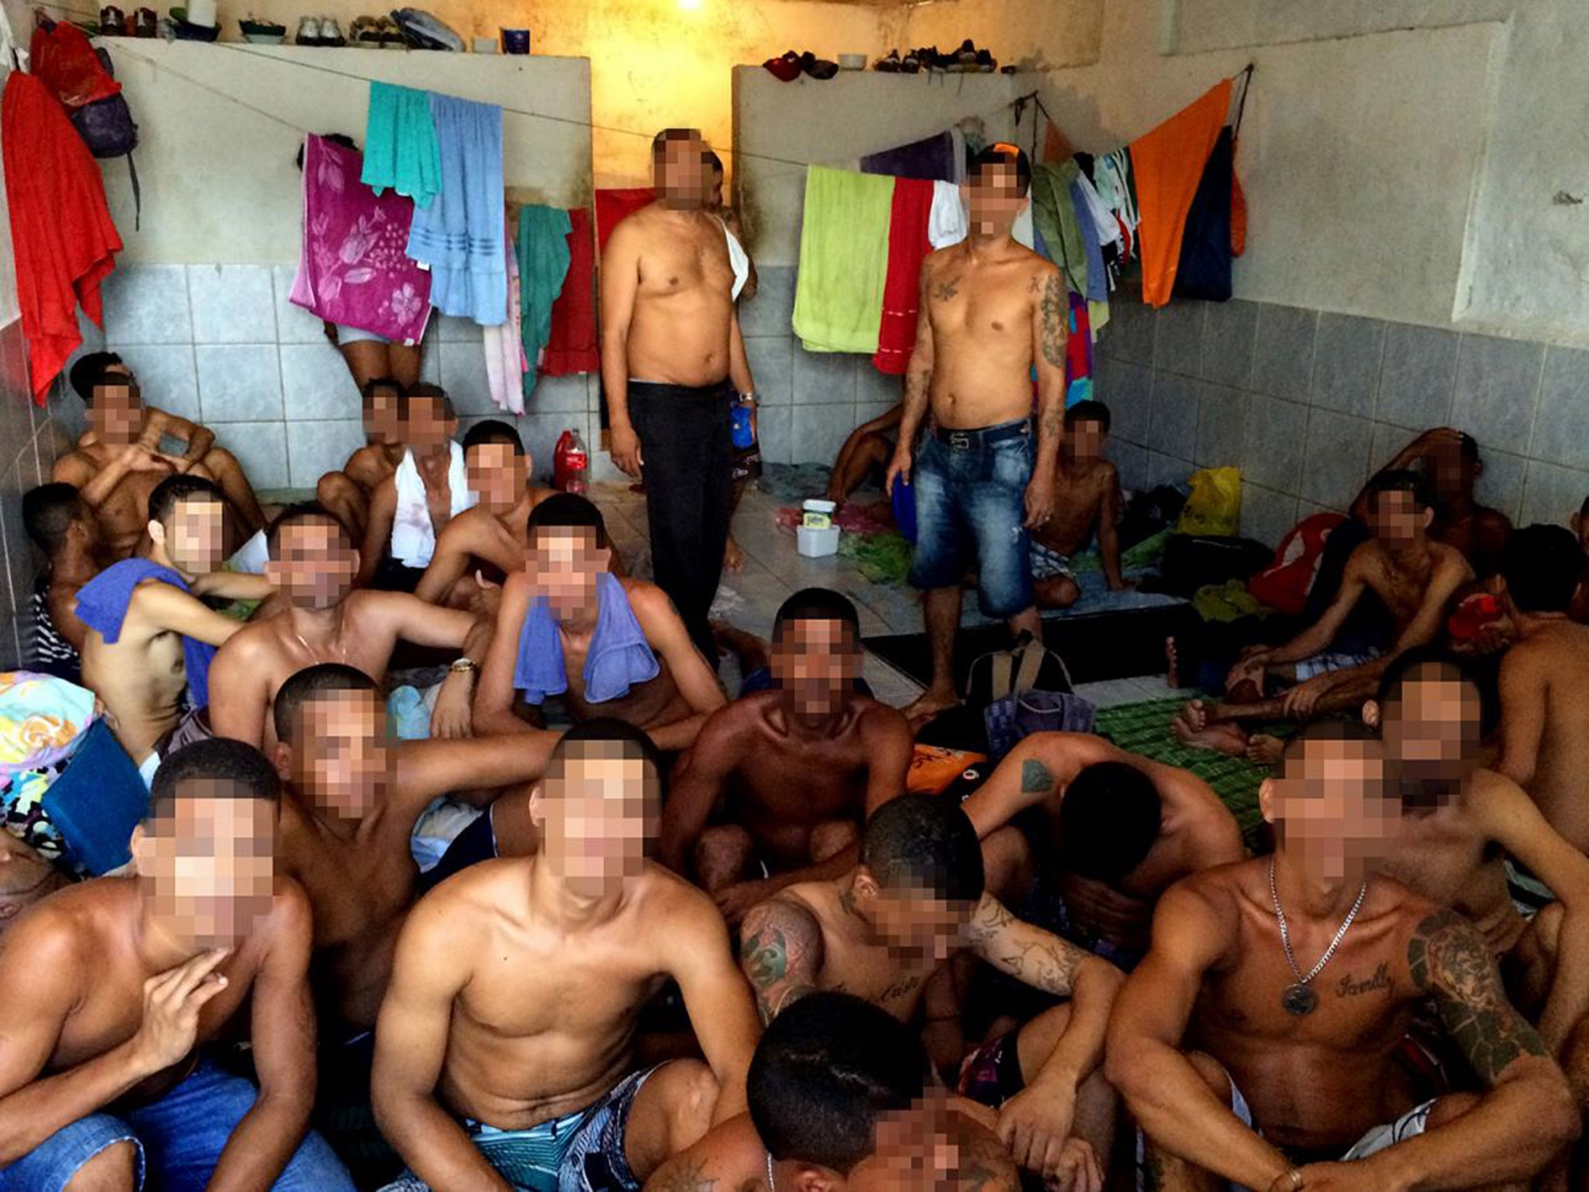
Tuberculosis in Prisons
Globally, TB incidence in prisons in LMICs is 33 (IQR: 15-36) times that of general pop.
Crowding
Poor Access to Care
Malnutrition
Drug Abuse
Tobacco use
HIV
Baussano et al, PLoS Med 2010
credit: Independent

Slide 3
Global Incarcerated Population
>10 million incarcerated individuals worldwide
74% are in Americas and Asia
Data source: Walmsley R, World Prison Population List, 11th Ed

Slide 4
Incarcerated Population Growth
(2000-2015)
Data source: Walmsley R, World Prison Population List, 11th Ed

Slide 5

Incarcerated Population by Country
676,000 prisoners

Slide 6
Brazil’s Incarcerated Population Grew >275% between 2000 and 2016
645
233

Slide 7
Brazil’s Incarcerated Population Grew >275% between 2000 and 2016
645
233

Slide 8
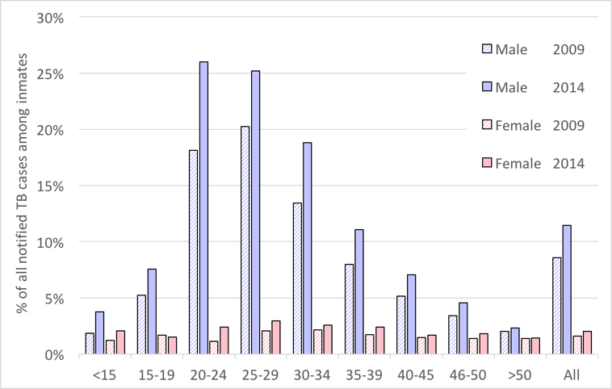
>25% of TB cases in young men occur in prisons
Bourdillon P, et al , Emerg Inf Dis, 2017

Slide 9
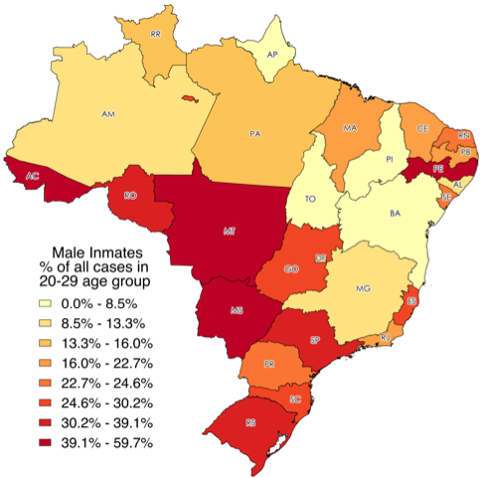
Particularly high burden among young men in border states
Bourdillon P, et al , Emerg Inf Dis, 2017
Notes:
This is a public health and social crisis of staggering proportions, and it’s not unique to Brazil. In fact, it’s not even unique to this century.

Slide 10
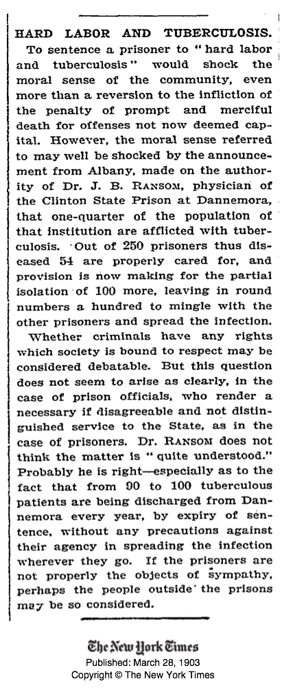
New York Times, 1903
Notes:
Here is the New York Times talking about this injustice and our moral failings on this issue in 1903.

Slide 11
Hypotheses and Framework
TB epidemics in low- and middle-income countries are increasingly concentrated in high-risk subpopulations, including prisons
Prisons serve as “reservoirs” or “amplifiers” for TB in the general population
The epidemiological rationale for focusing TB control efforts in prisons aligns with our moral obligation to tackle disparities and injustices

Slide 12
High Risk,
High Transmission
Low Risk,
Low Transmission
Outflow
TB Incidence Disparities
Size
Inflow
Mixing Patterns
“Institutional Amplifier”

Slide 13
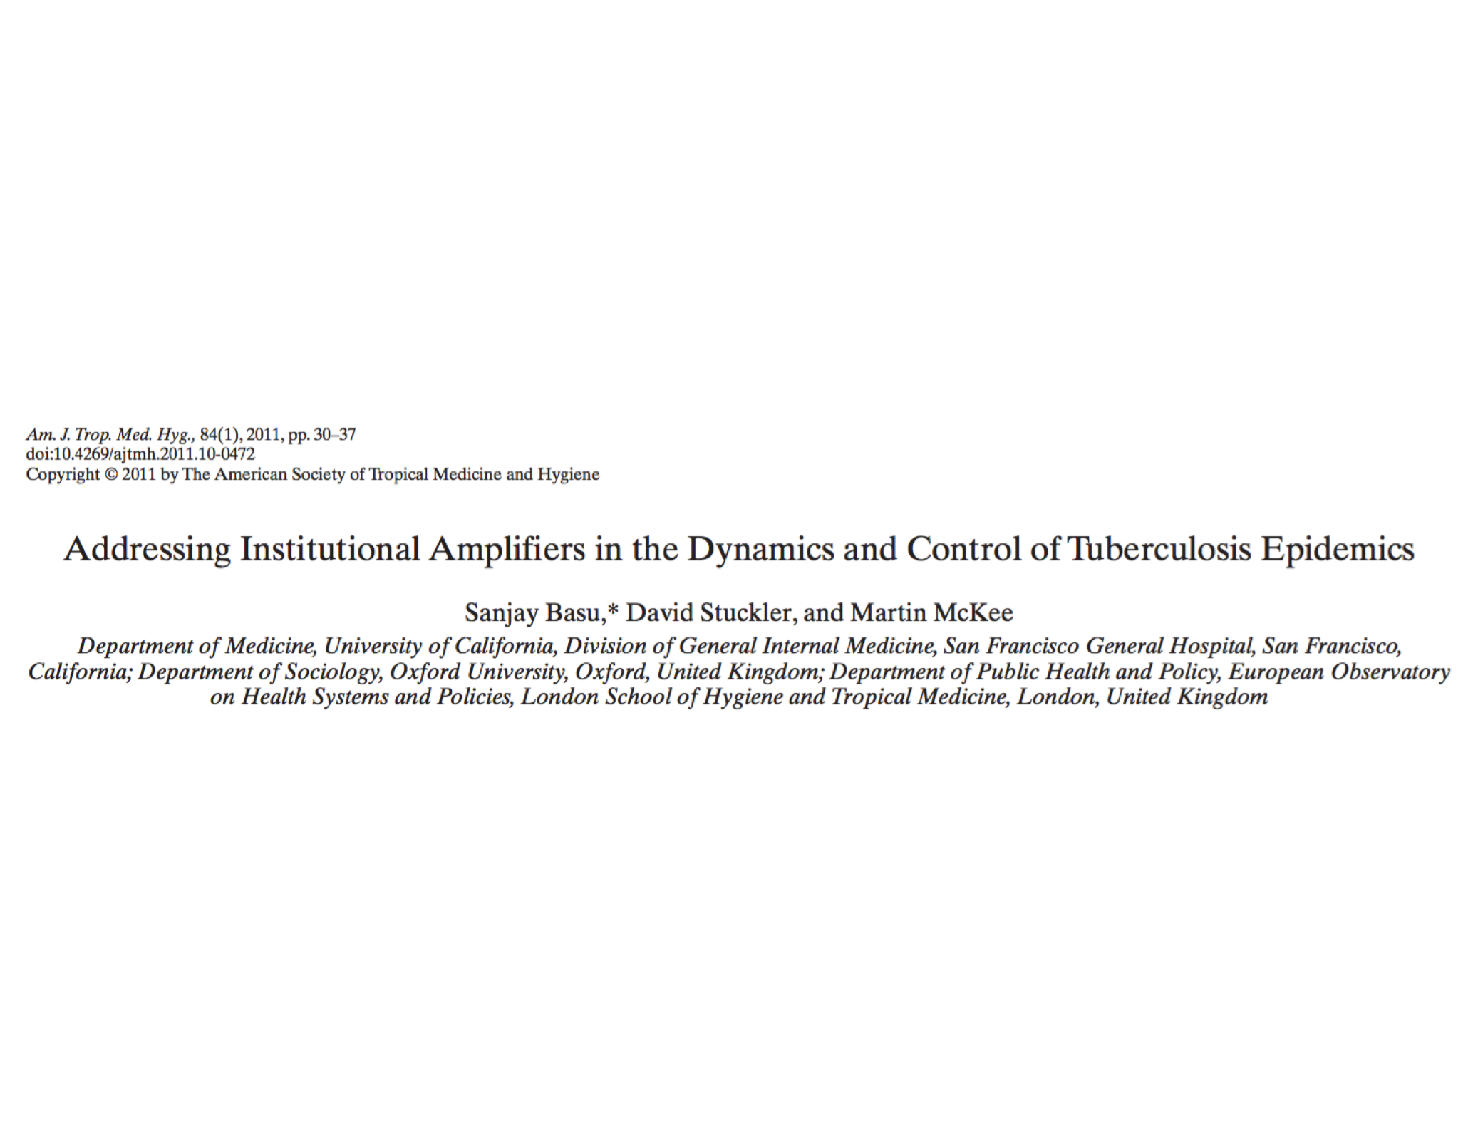
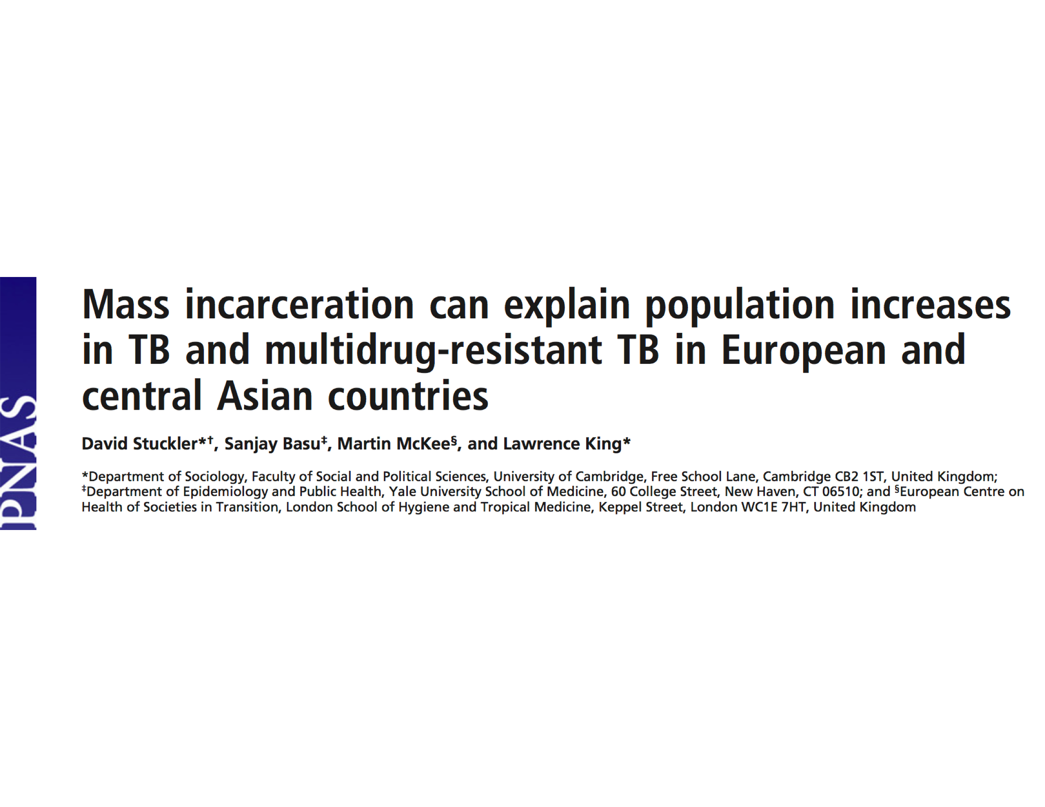
Is this effect causal?
How do prisons drive community TB epidemics?
Can we effectively address this and impact TB in prisons and at the population level?

Slide 14
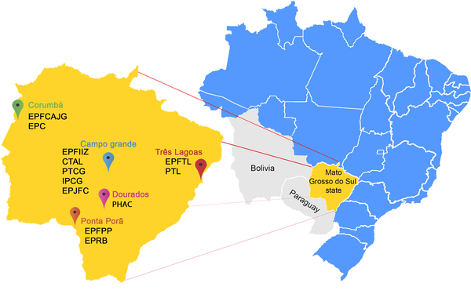
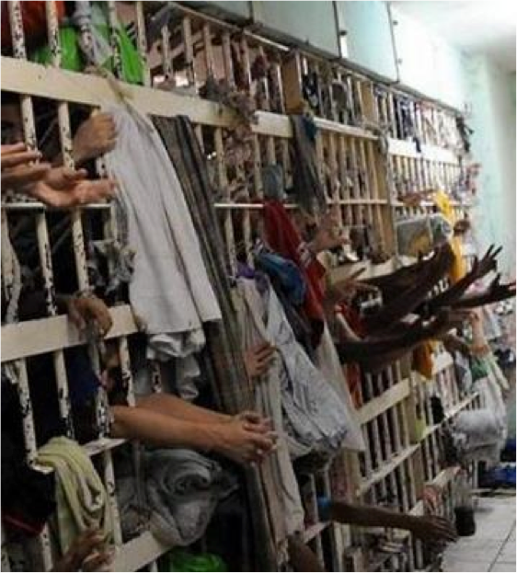
Mato Grosso do Sul, Brazil
TB incidence (per 100k)
General pop: 35
Prisons: 1,800

Slide 15
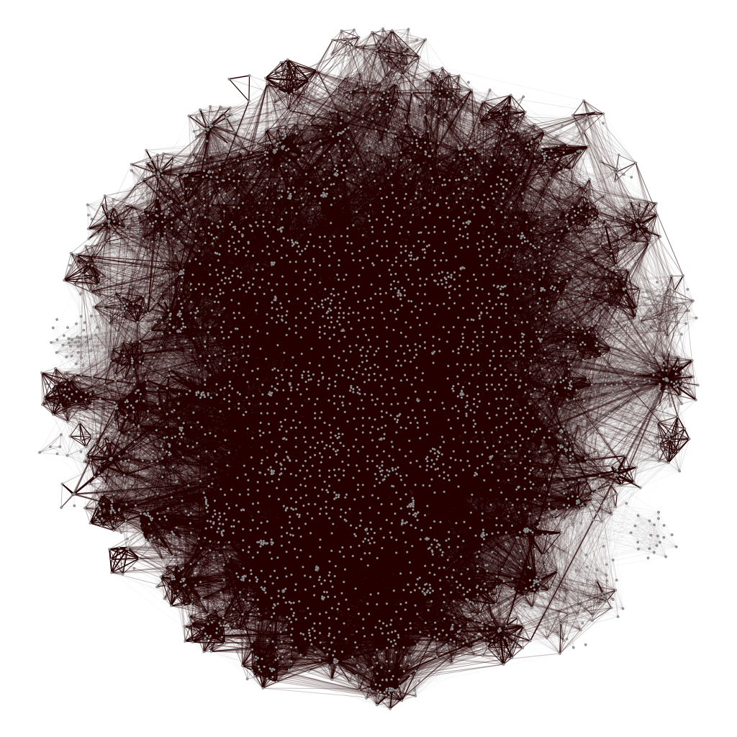
Lakkam M, et al, In Preparation

Slide 16
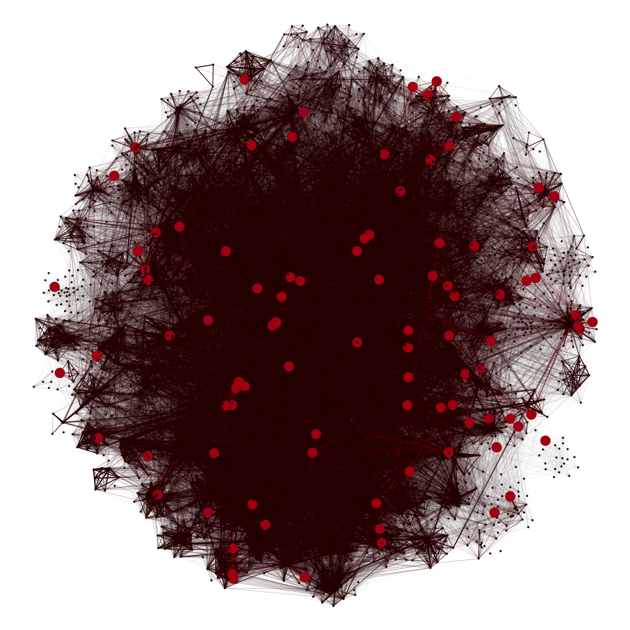
One year TST conversion: 42%
Lakkam M, et al, In Preparation

Slide 17
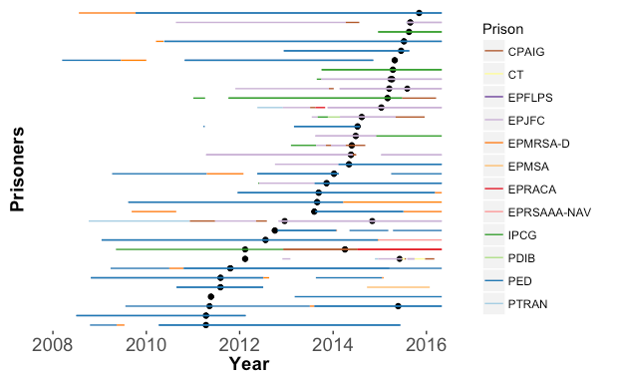
TB Spread Between Prisons
One RFLP type seen in 12 prisons over five years

Slide 18
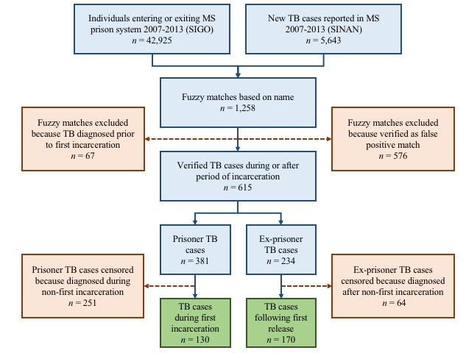

Are prisons driving the population-level TB epidemic in Brazil?
Tarub Mabud

Slide 19
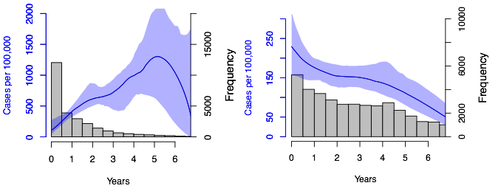
Timing of TB among prisoners
Prisoners
Mabud T, et al. Submitted

Slide 20
Timing of TB among prisoners
Prisoners
Ex-prisoners
Mabud T, et al. Submitted

Slide 21
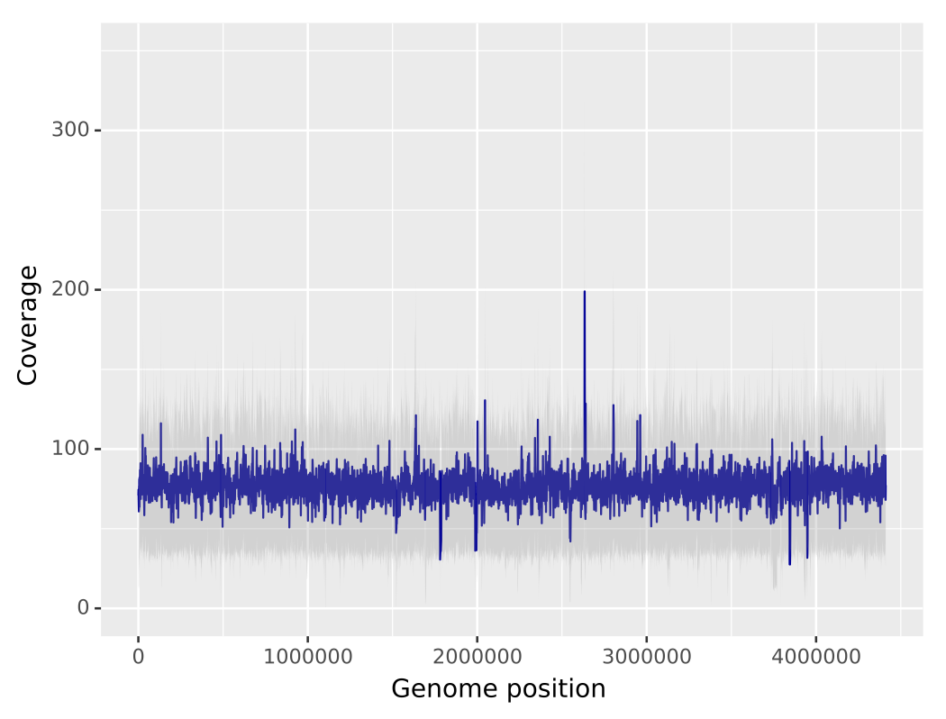

Whole Genome Sequencing for Evaluating Transmission Spillover
Population-based surveillance covering 90% of pulmonary TB cases in four largest cities
Every newly diagnosed patient visited and administered structured questionnaire
617 isolates sequenced on Illumina NextSeq
77x mean coverage
Katharine Walter

Slide 22
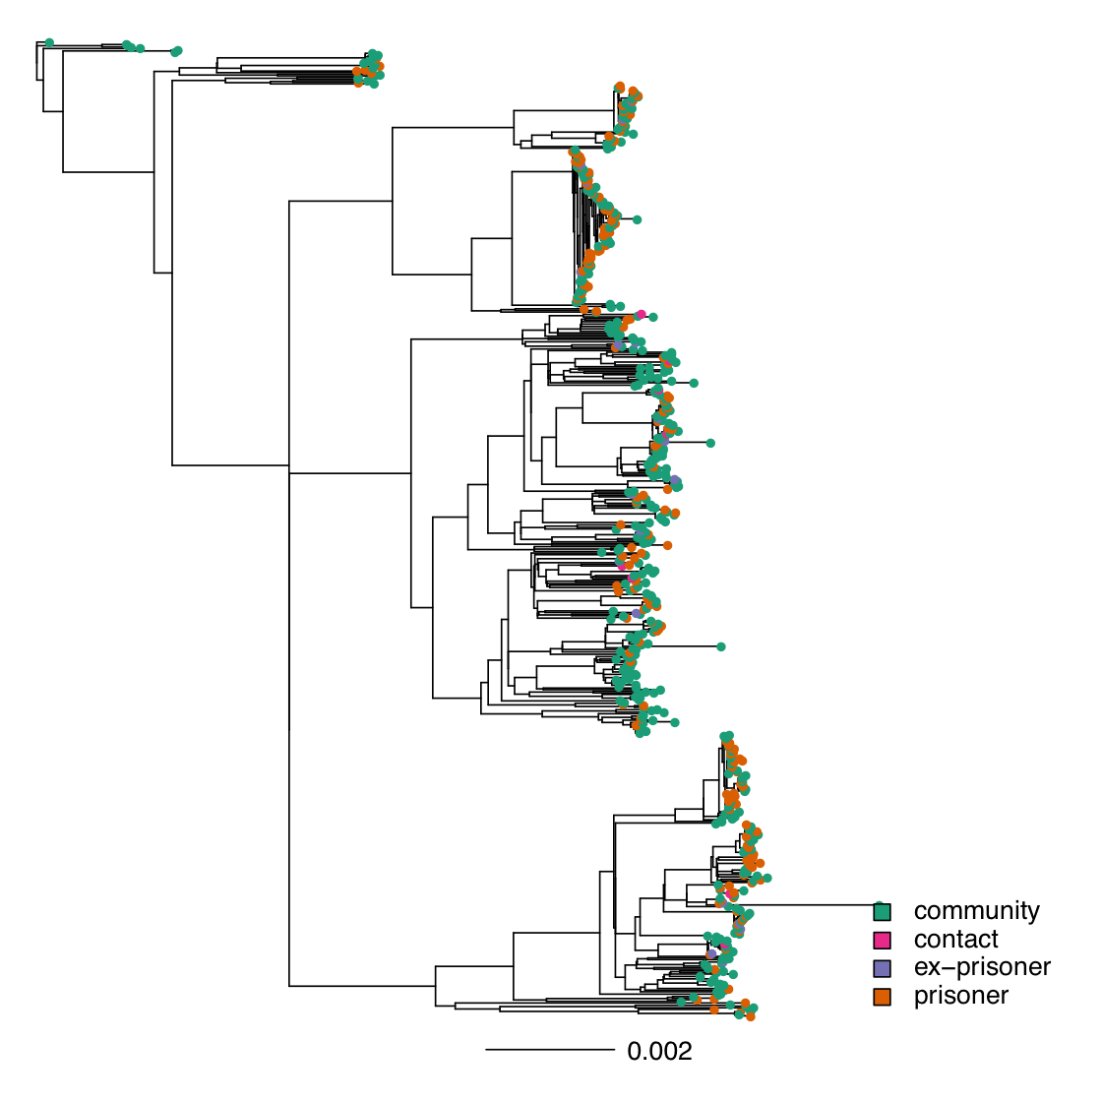
Prison and community TB epidemics are closely interrelated.
RFLP Type 10
Rooted maximum likelihood tree (RAxML)
617 isolates
14,298 SNPs
Branch lengths in substitutions/ site

Slide 23
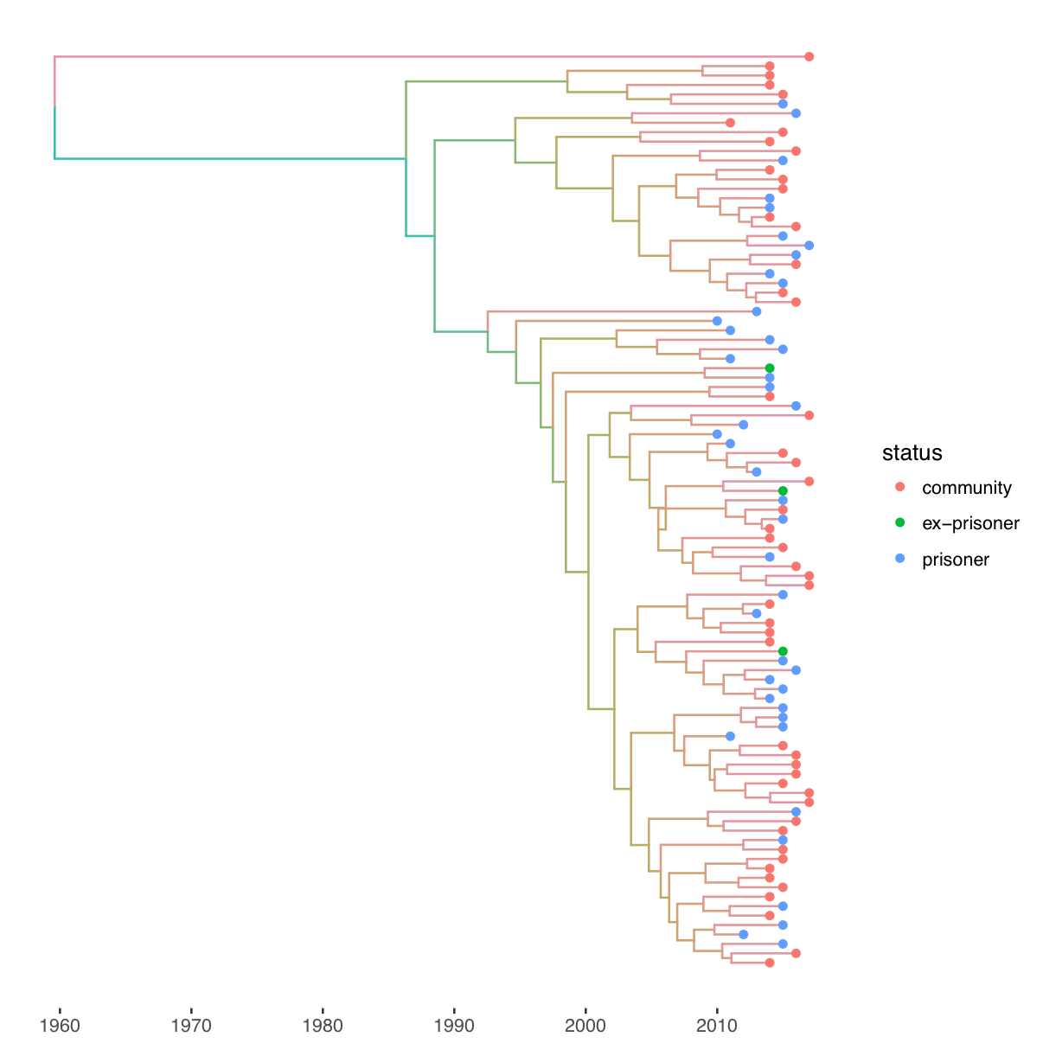
A recently emerged, clonal TB outbreak spans prisons and the community.
Bayesian time-calibrated phylogeny (BEAST)
97 RFLP type 10 isolates
173 SNPs
Strict clock, constant population size
Branch lengths in years
Nearly half of community isolates are most genetically similar to isolates from prisoners or ex-prisoners
Notes:
Branches are colored on a gradient according to date of most recent node or tip.
44 % (22 of 50) isolates from community members most closely related to isolates from prisoners or ex-prisoners, in this emerging cluster.

Slide 24
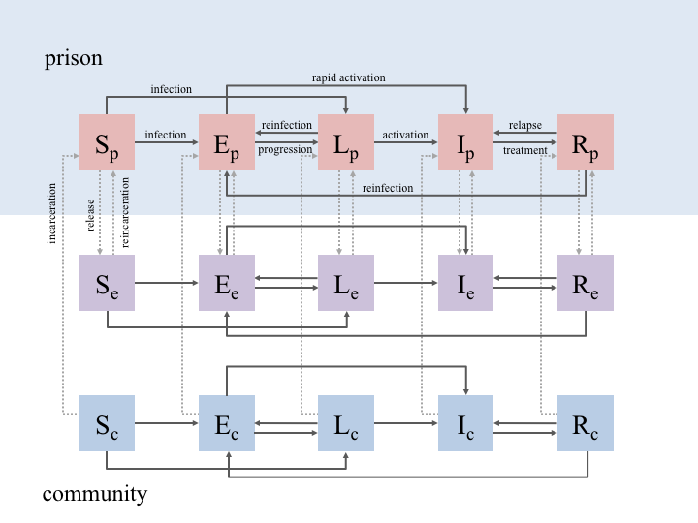
Projecting the impact of prison-based screening on TB in the general population
Prisoners
Former Prisoners
Never Incarcerated

Slide 25
Projecting the impact of prison-based screening on TB in the general population
Calibrated the model to local data
Simulated TB control interventions in the prison, including:
      improved diagnostics
      entry screening
      exit screening
      annual mass screening
      IPT
Project impact on TB epidemic in prisons and in general population over the course of 10 years

Slide 26
Projecting the impact of prison-based screening on TB in the general population
>30% reduction in community TB burden
Exit screening more beneficial than entry screening
10 year proportionate decrease in TB incidence

Slide 27
Conclusions
Prisoners bear a highly disproportionate burden of TB globally, and this burden may be growing
Concentrated epidemics in prisons may amplify general TB epidemics; novel methods integrating genomic and conventional epidemiologic data may more rigorously quantify this effect
Targeted interventions to concentrated, high-risk populations may yield substantial gains for TB control in the broader population while addressing health disparities and injustices

Slide 28

Stanford
Acknowledgements
Imperial College
Milinda Lakkam
Tarub Mabud
Sunita Patil
Katharine Walter
Leonardo Martinez
Nathan Lo
Sanjay Basu
Khatri lab
Banaei lab
Caroline Colijn
Columbia
Barun Mathema
Funding
NIH, CNPq, Fiocruz, BMGF
UFGD/UFMS/FIOCRUZ
Julio Croda Luana Ferro Luciane Saracho
Dayse Sanchez Guimarães Crhistinne Goncalves Cassia Reis
Andrea da Silva Santos Carbone Valeria Rolla Eunice Cunha
Flávia Sacchi Rafaela Vezozzo Crhistinne Gonçalves
Everton Lemos Roberto Oliveira Fabiano Silva
Mariana Tatara Camila Camioli de Lima Mario Neto
Odenir Amorim Paulo Cesar Santos Pedro Dias
Yale
Albert Ko
Juliana Urrego
Catherine Yeckel
Paul Bourdillon
Adeolu Aromolaran
Ted Cohen
Partners
State Agency for Management of Prisons
State Central Laboratory
National Tuberculosis Programme
Rede-TB
State Secretariat of Health
Mato Grosso do Sul State Government

